Slide 1


Slide 2
Patient demographic data
NAME : MRS. Lakshmi vaidehi D.O.A :23/7/23
AGE: 28 years LMP: 22/12/23
MR. NO: 806677 EDD: 27/09/24
OBSTETRIC SCORE : G1 P0L0A0 30.3 WEEKS
DIAGNOSIS: pre eclampsia ,gestational diabetic mellitus and FGR with fetal doppler compromise
WEIGHT: 95.4KG
HEIGHT : 4.10CM
BACKGROUND:
Spontaneous conception
No consangunious marriage
Family history : hypertension and diabetes :mother

Slide 3
Fetal movement pattern : present/regular
Chief complaints: women came with c/o: increased bp recording ,pre eclampsia,headache since 2days
Present pregnancy history/ details: primi 30.3 weeks of gestation
She had her initial antenatal checkup elsewhere
Patient came to er with increased bp recording bp 190/110mm Hg .
She received ab labetalol 200mg 8th hrly and tab nicardia 20mg 8th hrly adviced admission for ip monitoring
Presenting signs and symptoms :
Headache
Pedal oedema 2+
Urine albumin 2+
Bp 190/110 mm Hg

Slide 4
Complication : intrauterine growth retardation
Patient investigation done :
Blood group : b positive
HBsAg: negative
HIV: non reactive
Anti HCV: non reactive
Uine c/s : sterile
Urinary protein : 648mg/dl
Platelet count : 2.29lakh
LDH: 330U/L
Urinary protein /creatinine ratio: 6.5
Urine albumin 2+

Slide 5


Slide 6
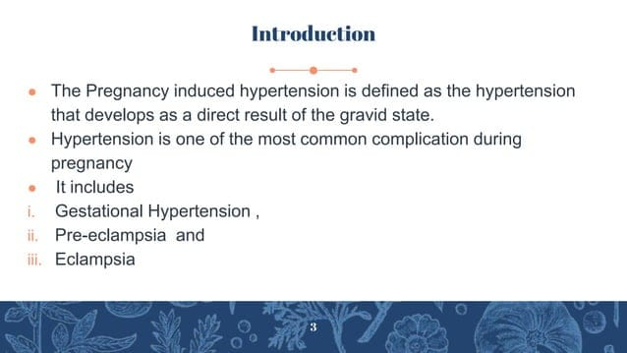

Slide 7
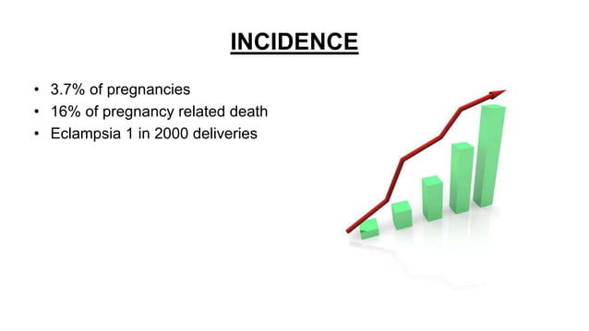

Slide 8
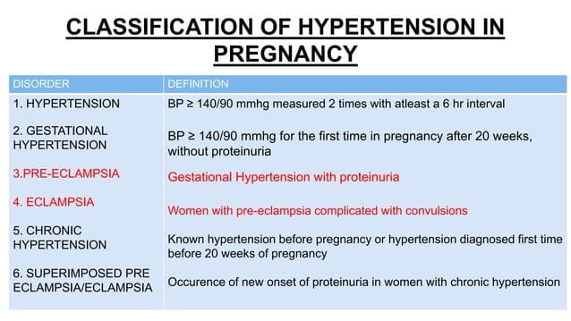

Slide 9
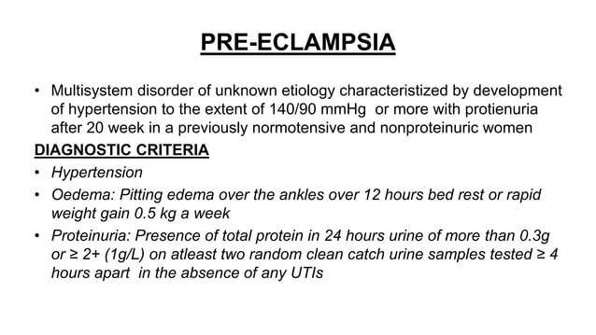

Slide 10
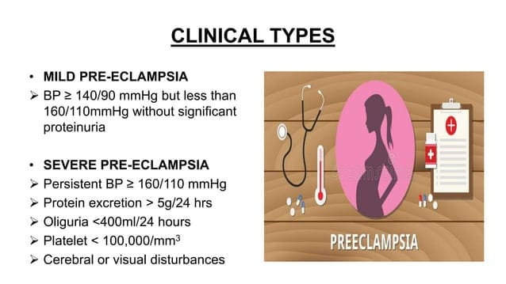

Slide 11
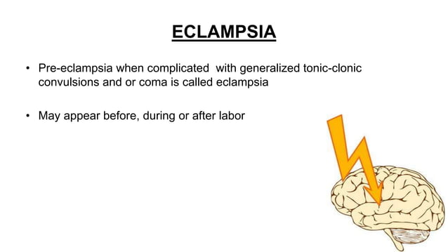

Slide 12


Slide 13
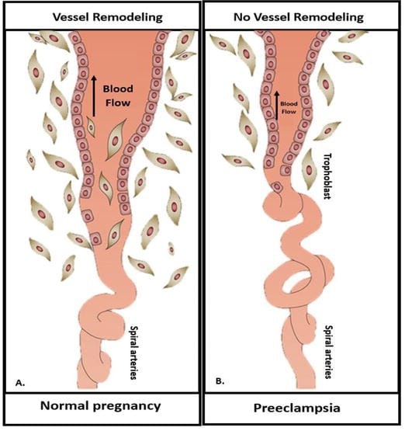
PATHOPHYSIOLOGY

Slide 14


Slide 15
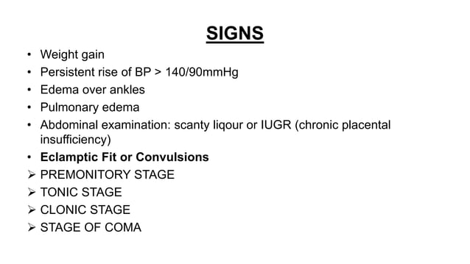

Slide 16
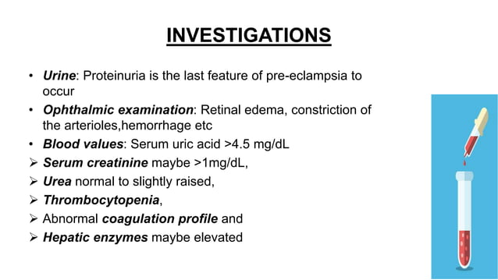

Slide 17
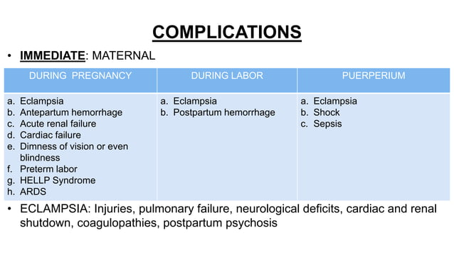

Slide 18
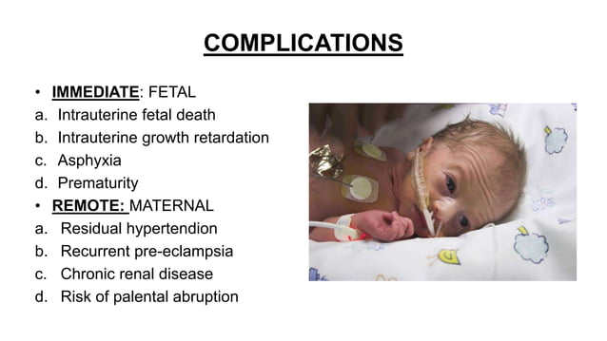

Slide 19
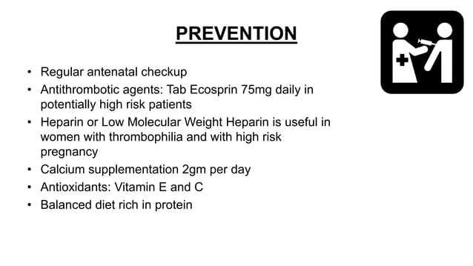

Slide 20
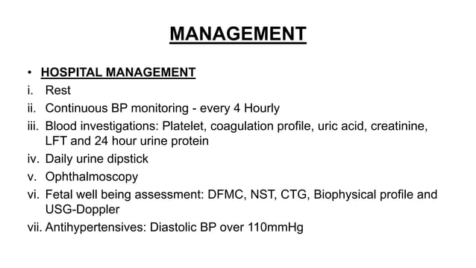

Slide 21
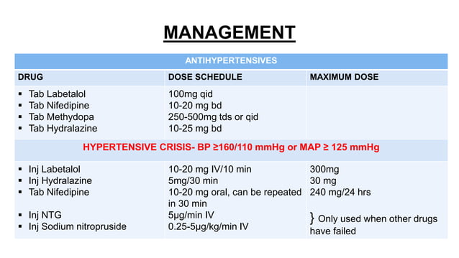

Slide 22
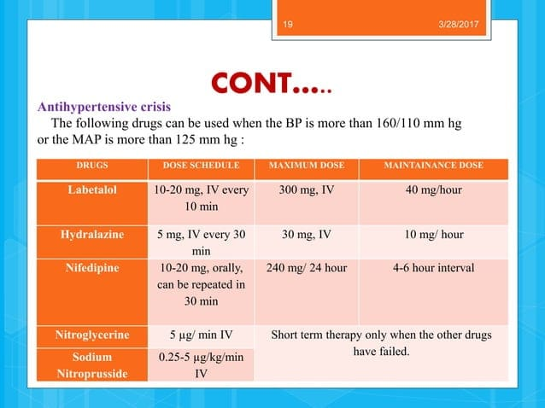

Slide 23
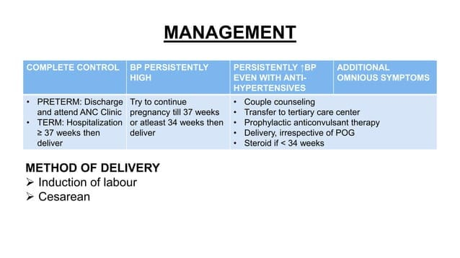

Slide 24
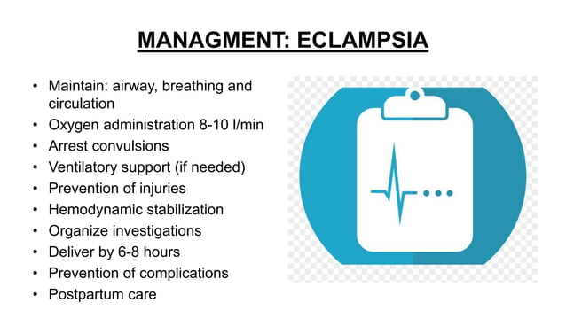

Slide 25
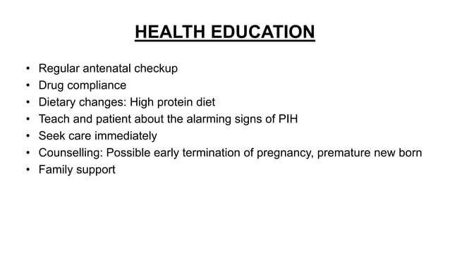

Slide 26


